Slide 1
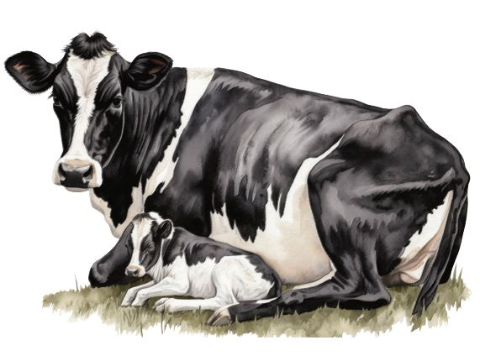
The Sacramento County 2023 Crop and Livestock Report
October 8, 2024

Slide 2
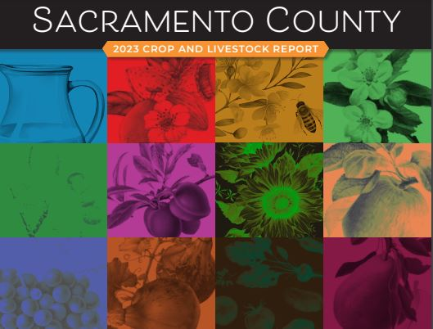
Gross Value of Sacramento Agricultural Production
2023 Value = $584,802,000

Slide 3
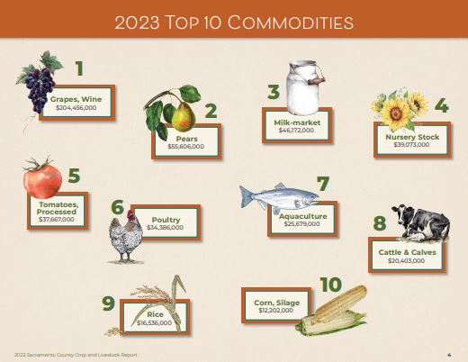
Top Ten Leading Commodities
Grapes - $204,456,000
Pears - $55,606,000
Market Milk - $46,172,000
Nursery - $39,073,000
Tomatoes - $37,667,000
Poultry - $34,386,000
Aquaculture - $25,679,000
Cattle & Calves - $20,403,000
Rice - $16,536,000
Corn, Silage - $12,202,000

Slide 4
Overall Trends
Increases in Value:
Decreases in Value:
Almonds
Cattle & Calves
Cherries
Nursery Stock
Poultry
Processing Tomatoes
Rice
Seed Crops
Walnuts
Wine Grapes
Alfalfa
Apiary Products
Aquaculture
Corn
Market Milk
Pears

Slide 5
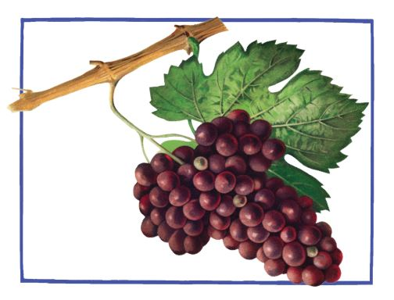
Protecting Agriculture in Sacramento County
Pest Detection Update
11 different types of traps are deployed to catch non-native, invasive pests
Agricultural Aides “serviced” pest detection traps 53,528 times
Japanese Beetles & Oriental Fruit Flies discovered!
GWSS & EGVM
To protect wine grapes:
439 Glassy-Winged Sharpshooter traps deployed
1,047 European Grapevine Moth traps deployed

Slide 6
Supporting Agriculture in Sacramento County
Pest Exclusion Update
In 2023, Ag Inspectors & our Canine Team inspected 4,957 produce & plant shipments
227 shipments were rejected
59 pests were discovered!
Phytosanitary Certificate Program
4,031 Certificates issued in 2023
51 countries received exported ag commodities from Sacramento County

Slide 7
Supporting Agriculture in Sacramento County
Nursery Program
Ag Inspectors conduct inspections at wholesale and production nurseries to ensure that plants are free from pests, weeds, and diseases
There are 72 wholesale & production nurseries
Apiary Program
143 registered beekeepers and 5,375 registered hives
We protect bees by connecting beekeepers and pesticide applicators

Slide 8
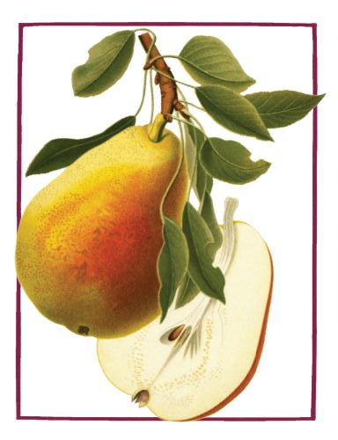
Organic Growers & Certified Producers
In 2023, 21 Certified Organic growers farmed 2,918 acres
The total gross production value of organic commodities was over $4.8 million dollars!
In 2023, 107 Certified Producers farmed 790 acres
There were 699 different types of agricultural commodities grown
There are 24 Certified Farmers Markets currently operating; 17 of those markets are year-round

Slide 9
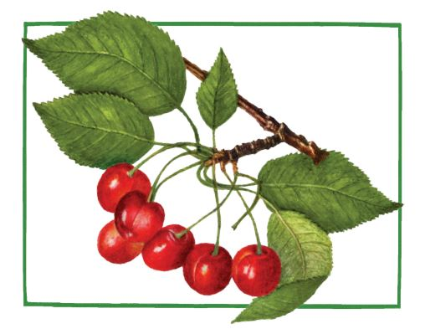
Pesticide Use Enforcement Supports Agriculture
Promotes the safe and effective use of pesticides
Offers education and outreach events and training to pesticide applicators
In 2023, Agricultural Inspectors conducted 356 pesticide-related inspections & 53 investigations
In 2023, Ag Inspectors proctored 57 Private Applicator exams
Issued 498 permits
Plays a crucial role in safeguarding public health & the environment

Slide 10
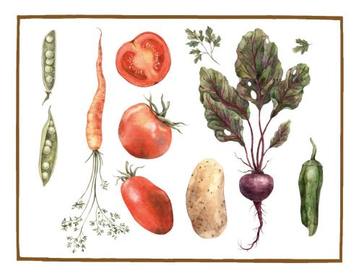
Weights & Measures Supports Agriculture
23,369
The # of
Weighing & Measuring devices inspected!
22
The # of livestock scales inspected!
138
The # of Certified Farmers Market scales inspected!
119
The # of vehicle scales inspected!

Slide 11
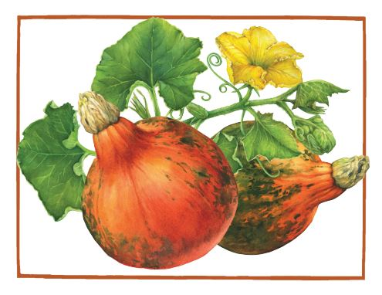
Thank You!
Presenters:
Chrisandra Flores, Agricultural Commissioner/ Sealer of Weights & Measures
Kevin Martyn, Deputy Agricultural Commissioner over Agricultural Programs
David Smith, Deputy Agricultural Commissioner over Pesticide Use Enforcement
Breanne Matsuura, Deputy Sealer over Weights & Measures Programs

